Slide 1


Employee Management System

Slide 2
My self GOPIREDDY VENKAT THARUN ,i am from B.Tech AI&DS branch.Data Science is one of the most in-demand fields, offering roles like Data Analyst, Machine Learning Engineer, and Data Scientist across industries.It empowers you to make better, evidence-based decisions by analyzing and interpreting data effectively.Data Science drives innovation in AI, healthcare, finance, and more — helping solve real-world problems using data.I don’t have formal work experience yet.
Linkehttps:https://www.linkedin.com/in/gopireddy-venkat-tharun-47449b343/
GitHub:https://github.com/gopireddytharun58-spec

Slide 3
Agenda :
Objective of the Project
ER Diagram and schema explanation
Key analysis questions (use cases)
SQL query results with screenshots or summaries
Final business insights and recommendations
Conclusion (Key finding overall)
Q&A Slide
Your Experience/Challenges working on SQL – Data Analysis Project.

Slide 4
Objective of the Project:
The main objective of the Employee Management System is to efficiently manage and organize employee information within an organization.It aims to store, update, and retrieve employee details such as personal data, job roles, and department information securely.The system helps reduce manual workload and human errors by automating employee record management.It ensures smooth operations through features like salary tracking, attendance monitoring, and job assignment.The project enhances data accuracy,accessibility, and consistency across departments.Overall, it aims to create a reliable, user-friendly, and efficient database system for employee management.

Slide 5
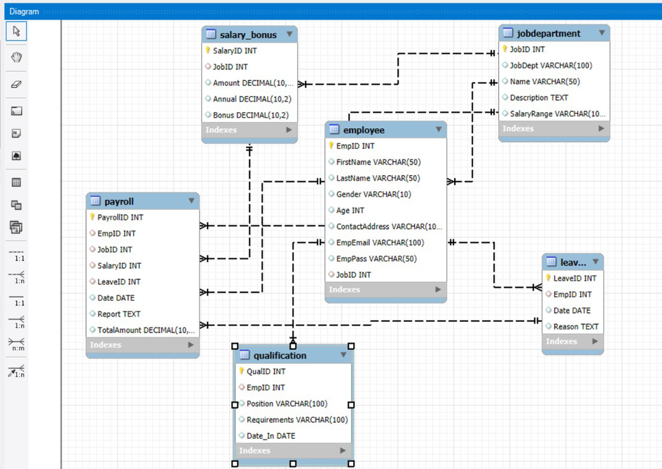
ER Diagram explanation:
The Employee Management System ER Diagram illustrates the database structure designed to manage employee information efficiently. It includes six entities — employee, jobdepartment, salary_bonus, payroll, qualification, and leave — connected through relationships to ensure smooth data flow. The employee table serves as the core, linking each employee to their department,salary, qualifications, and leave details. The payroll table manages salary payments and reports, while salary_bonus defines pay structures for each job role. Overall, the diagram ensures data integrity, accuracy, and efficient management of all employee-related information within the organization.
Schema explanation:
The Employee Management System schema organizes and links various tables to manage employee data effectively. The central employee table stores personal and job-related details, with JobID connecting to the jobdepartment table for department, role, and salary range information. Salary details, including bonuses, are managed in the salary_bonus table linked to jobdepartment. The payroll table integrates employee, job, salary, and leave records to handle payment and reporting. Employee qualifications are recorded in the qualification table linked by EmpID, while leave records are maintained in the leave table, also connected via EmpID. This structure ensures data consistency, integrity, and efficient management across employees, departments, and payroll operations.

Slide 6
Key analysis questions (use cases)
How many unique employees are currently in the system?
Which departments have the highest number of employees?
Which job roles offer the highest salary?
What is the average number of leave days taken by its employees per department?
What is the total monthly payroll processed?
What is the average value of total_amount after considering leave deductions?

Slide 7
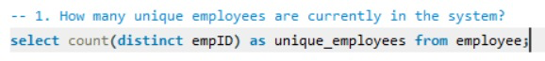
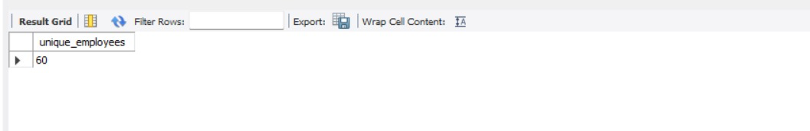
SQL query results with screenshots or summaries:
How many unique employees are currently in the system?

Slide 8
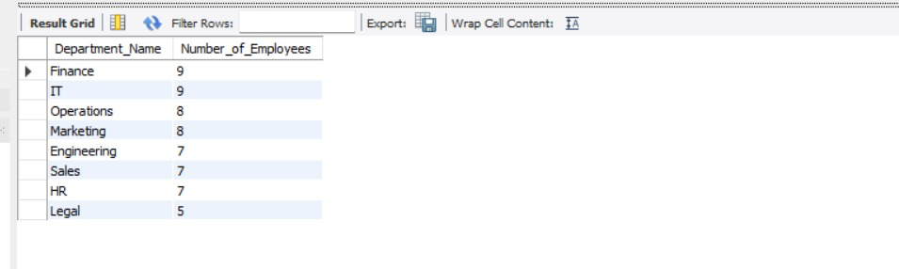
Which departments have the highest number of employees?

Slide 9
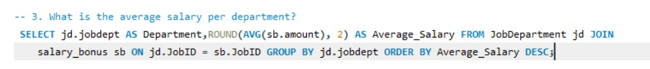
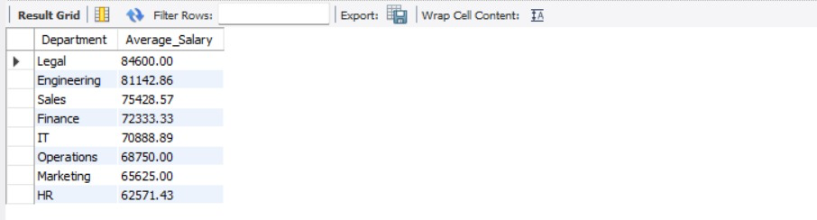
What is the average salary per department?

Slide 10
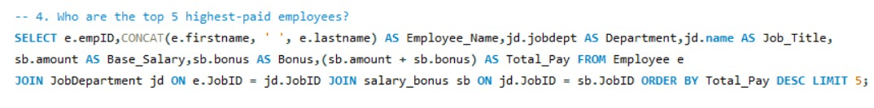
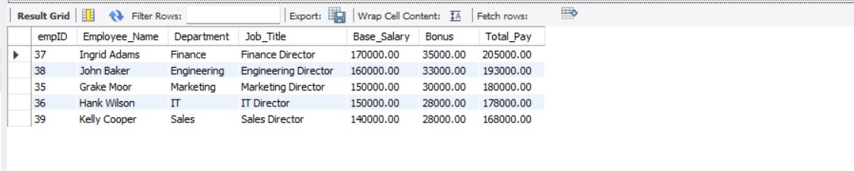
Who are the top 5 highest-paid employees?

Slide 11
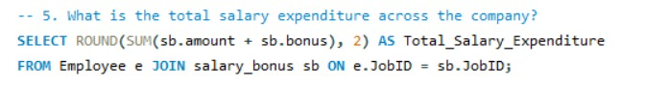
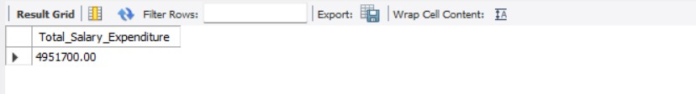
What is the total salary expenditure across the company?

Slide 12
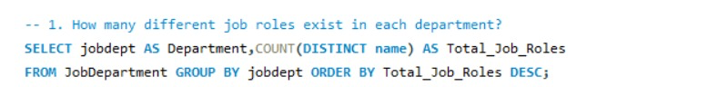
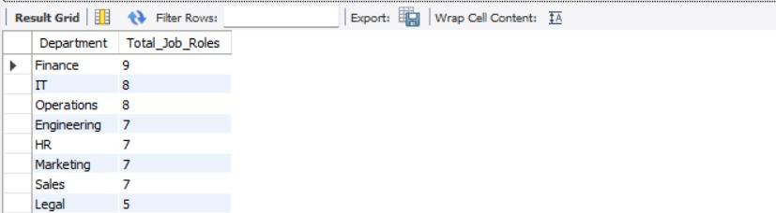
How many different job roles exist in each department?

Slide 13
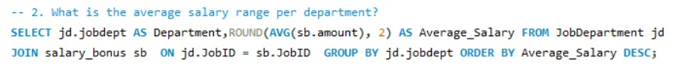
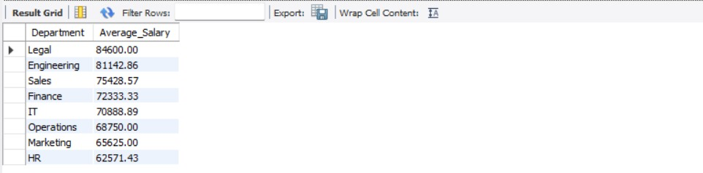
What is the average salary range per department?

Slide 14
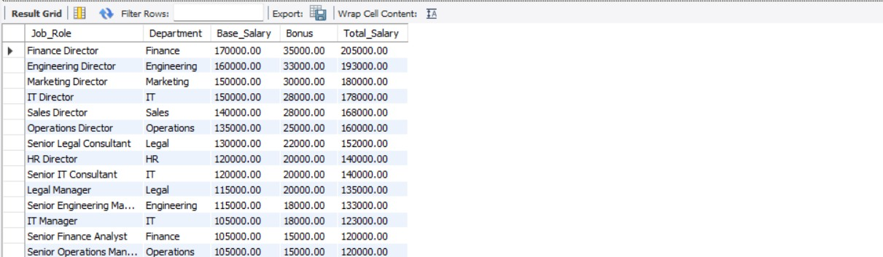
Which job roles offer the highest salary?

Slide 15
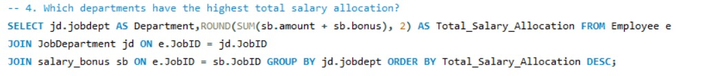
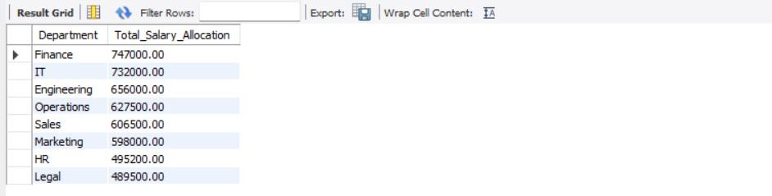
Which departments have the highest total salary allocation?

Slide 16
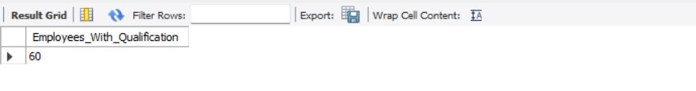
How many employees have at least one qualification listed?

Slide 17
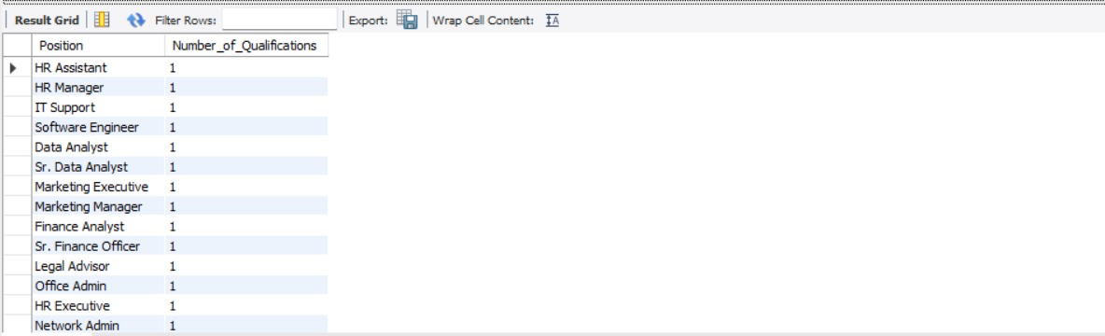
Which positions require the most qualifications?

Slide 18
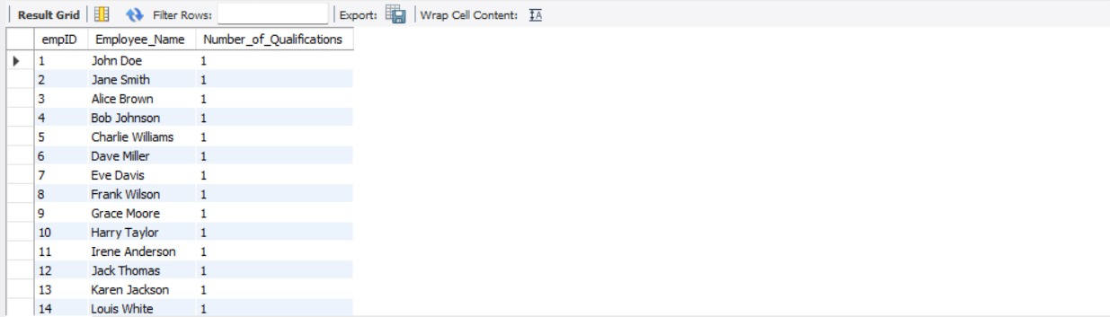
Which employees have the highest number of qualifications?

Slide 19
Which year had the most employees taking leaves?

Slide 20
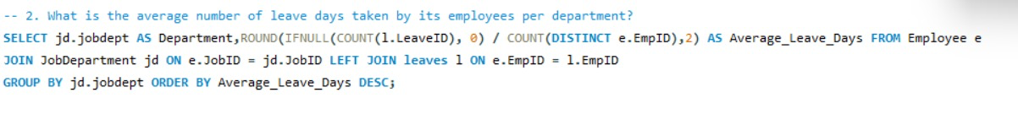
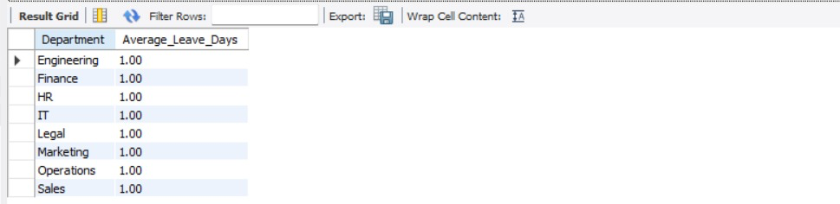
What is the average number of leave days taken by its employees per department?

Slide 21
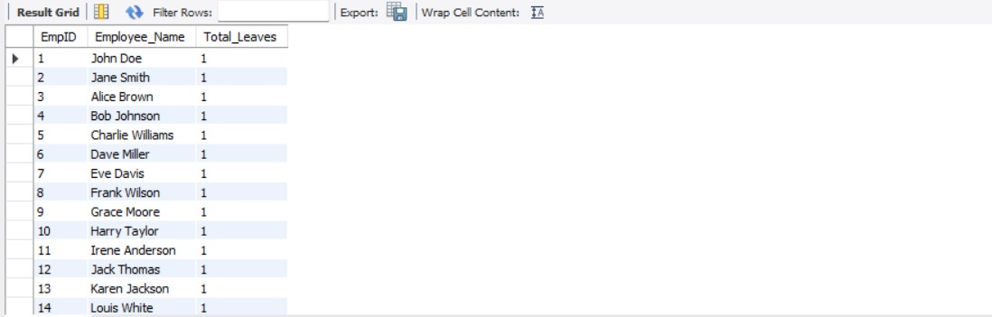
Which employees have taken the most leaves?

Slide 22
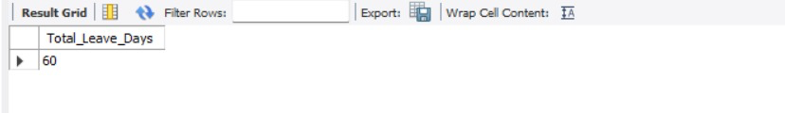
What is the total number of leave days taken company-wide?

Slide 23
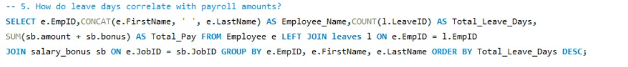
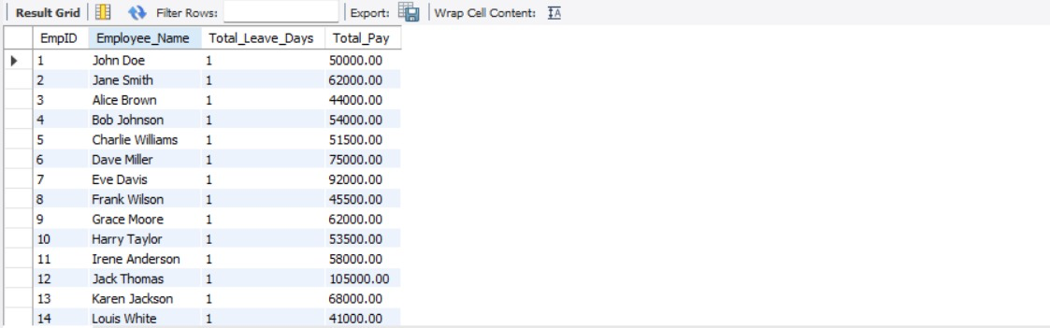
How do leave days correlate with payroll amounts?

Slide 24
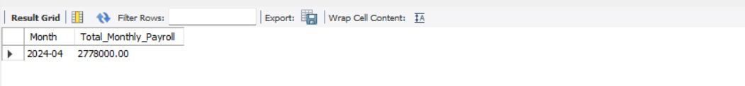
What is the total monthly payroll processed?

Slide 25
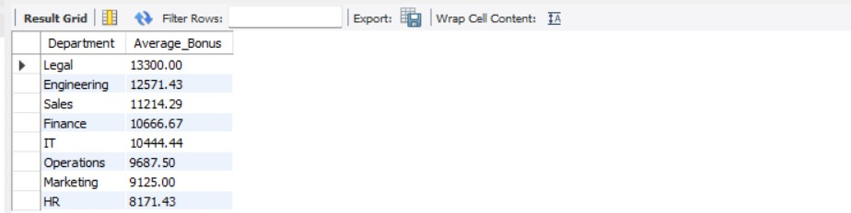
What is the average bonus given per department?

Slide 26
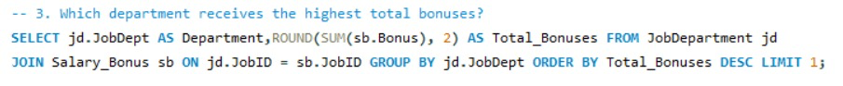
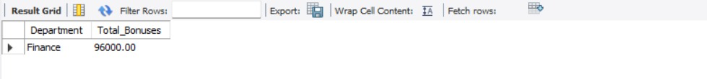
Which department receives the highest total bonuses?

Slide 27
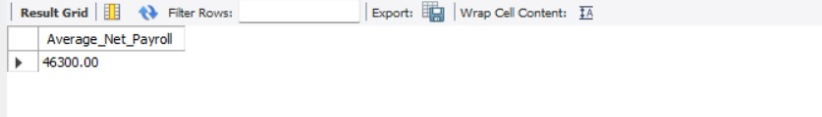
What is the average value of total_amount after considering leave deductions?

Slide 28
Final business insights and recommendations:
• Monitor headcount, joiners/leavers, and tenure by department to guide hiring, capacity planning, and retention actions.
• Control costs by comparing monthly payroll to budgets and role salary ranges, and fix out-of-range pay via releveling or band updates.
• Improve coverage by tracking leave rates and timing, planning cross-training and backfills where disruptions are likely.
• Accelerate internal mobility by matching qualifications and tenure to role requirements, and close skills gaps with targeted training.
• Safeguard data quality and compliance through automated checks for orphan/mismatched records, mandatory key fields, and approval workflows for pay changes.

Slide 29
Conclusion:
• The Employee Management System delivers a centralized, relational SQL design that unifies employees, departments, payroll, qualifications, and leave data, ensuring referential integrity and reliable reporting across HR operations.
• By aligning payroll with job roles and salary ranges, the system enables proactive cost control, highlights pay anomalies, and supports accurate monthly and annual budgeting decisions.
• Integrated leave tracking and qualification records improve workforce planning, ensuring coverage during absences while accelerating internal mobility through skills visibility and promotion readiness.
• Routine data-quality checks on foreign keys and mandatory fields strengthen audit readiness, reduce errors in payments and records, and increase trust in analytics-driven decisions.
• The project demonstrates scalable, query-first architecture that supports dashboards and KPI monitoring, enabling continuous optimization of staffing, compensation, and compliance processes.

Slide 30
Experiences And Challenges :
Database Design & Relationships – Built normalized tables with proper primary and foreign keys, ensuring data integrity across modules like Employee, Payroll, and JobDepartment.
Schema Modification & Constraints – Faced and resolved issues with altering tables, foreign key dependencies, and maintaining referential integrity using CASCADE and SET NULL.
Advanced Query Development – Created complex JOIN and aggregate queries for HR analytics such as salary insights, leave patterns, and departmental performance.
Error Handling & Optimization – Overcame data type mismatches, query logic errors, and performance issues through testing, indexing, and query refinement.
Key Learning Outcome – Gained strong practical understanding of SQL database management, real-world HR data modeling, and analytical problem-solving.

Slide 31

THANK YOU

